Slide 1
Norfolk Tobacco Control Alliance

Slide 2
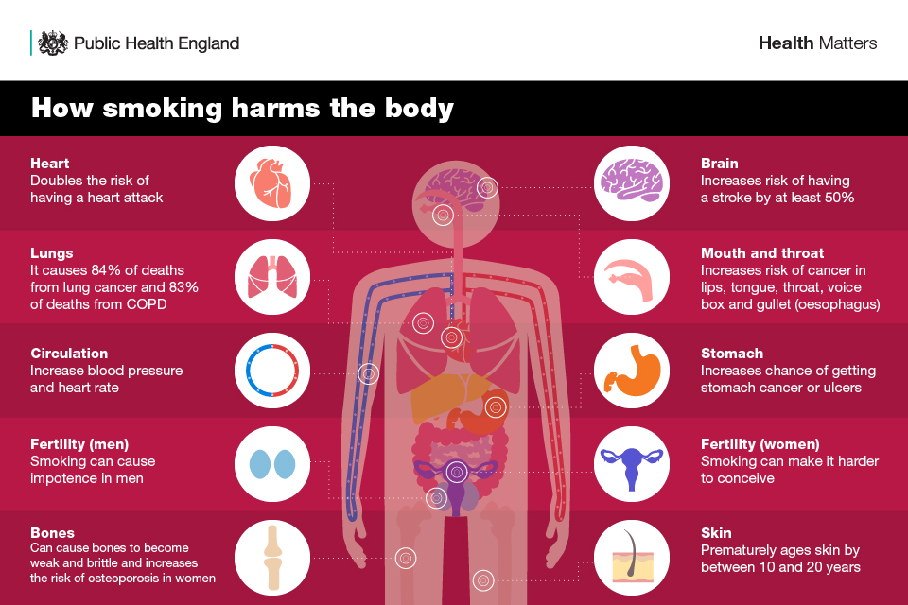
Impact of Smoking on Health

Slide 3
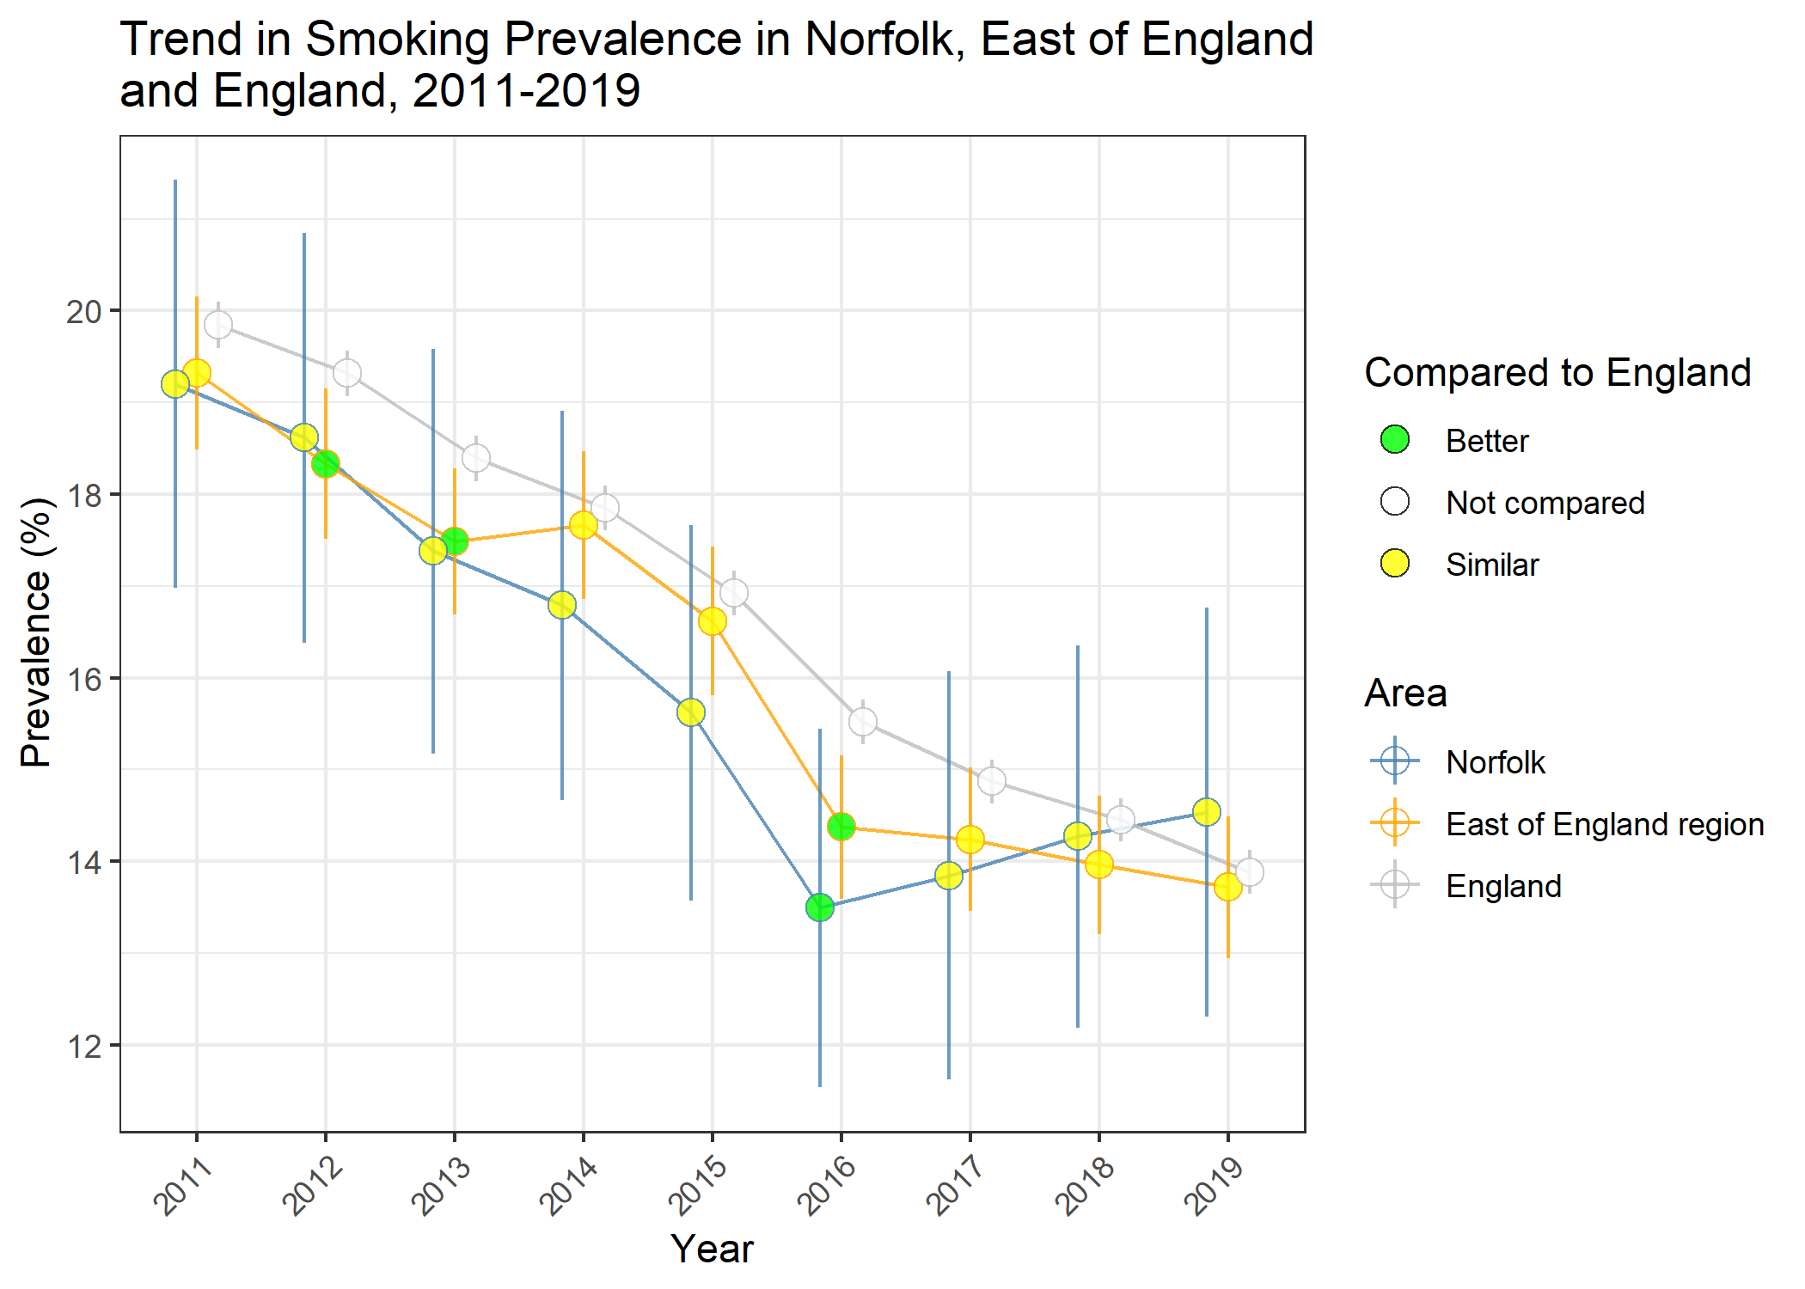
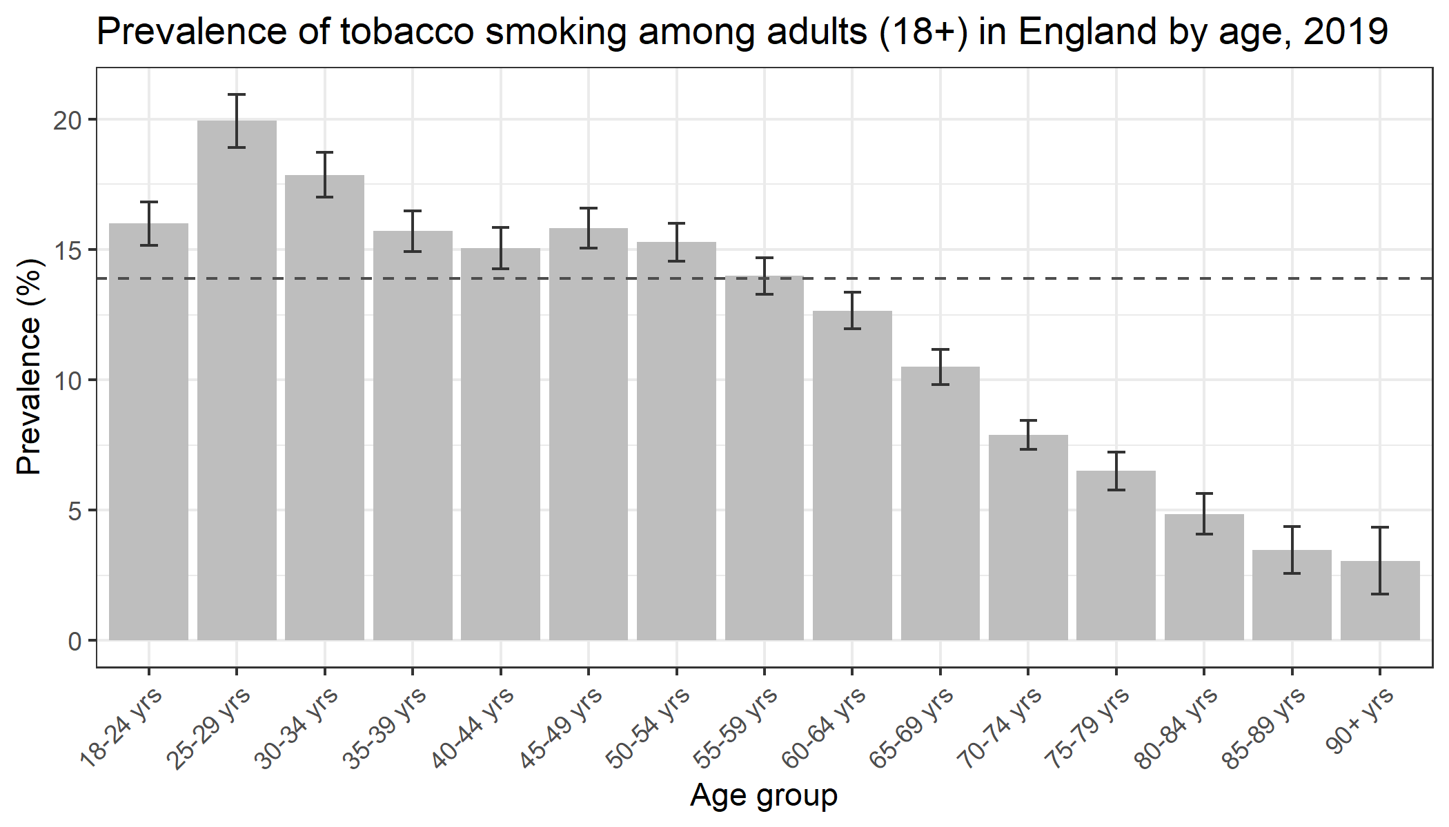
Prevalence of Smoking
Likelihood of smoking declines with age with those in the 25-29-year-old age group being the most likely to smoke (19.9%)
In Norfolk the number of people smoking was declining until 2016, since there has been a slight year-on-year increase.

Slide 4
National Tobacco Control Plan (2017)
Vision: ‘to create a Smokefree generation by 2030’
Target by 2022 to reduce:
Number of 15-year-olds who regularly smoke from 8% to 3% or less
Smoking among adults in England from 15.5% to 12% or less
This would mean reducing the number of adult smokers in Norfolk by 18,446
Inequality gap in smoking prevalence, between those in routine and manual occupations and the general population
Prevalence of smoking in pregnancy from 10.7% to 6% or less
This would mean reducing the number of women smoking at the time of delivery in Norfolk by 578

Slide 5
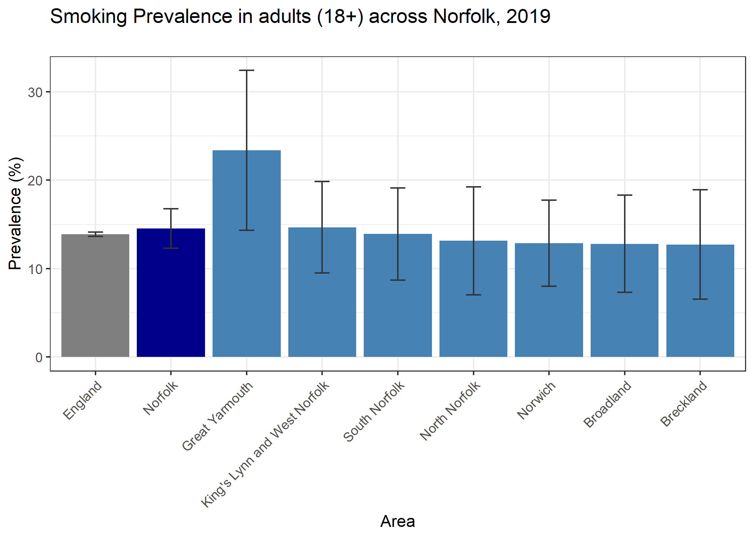
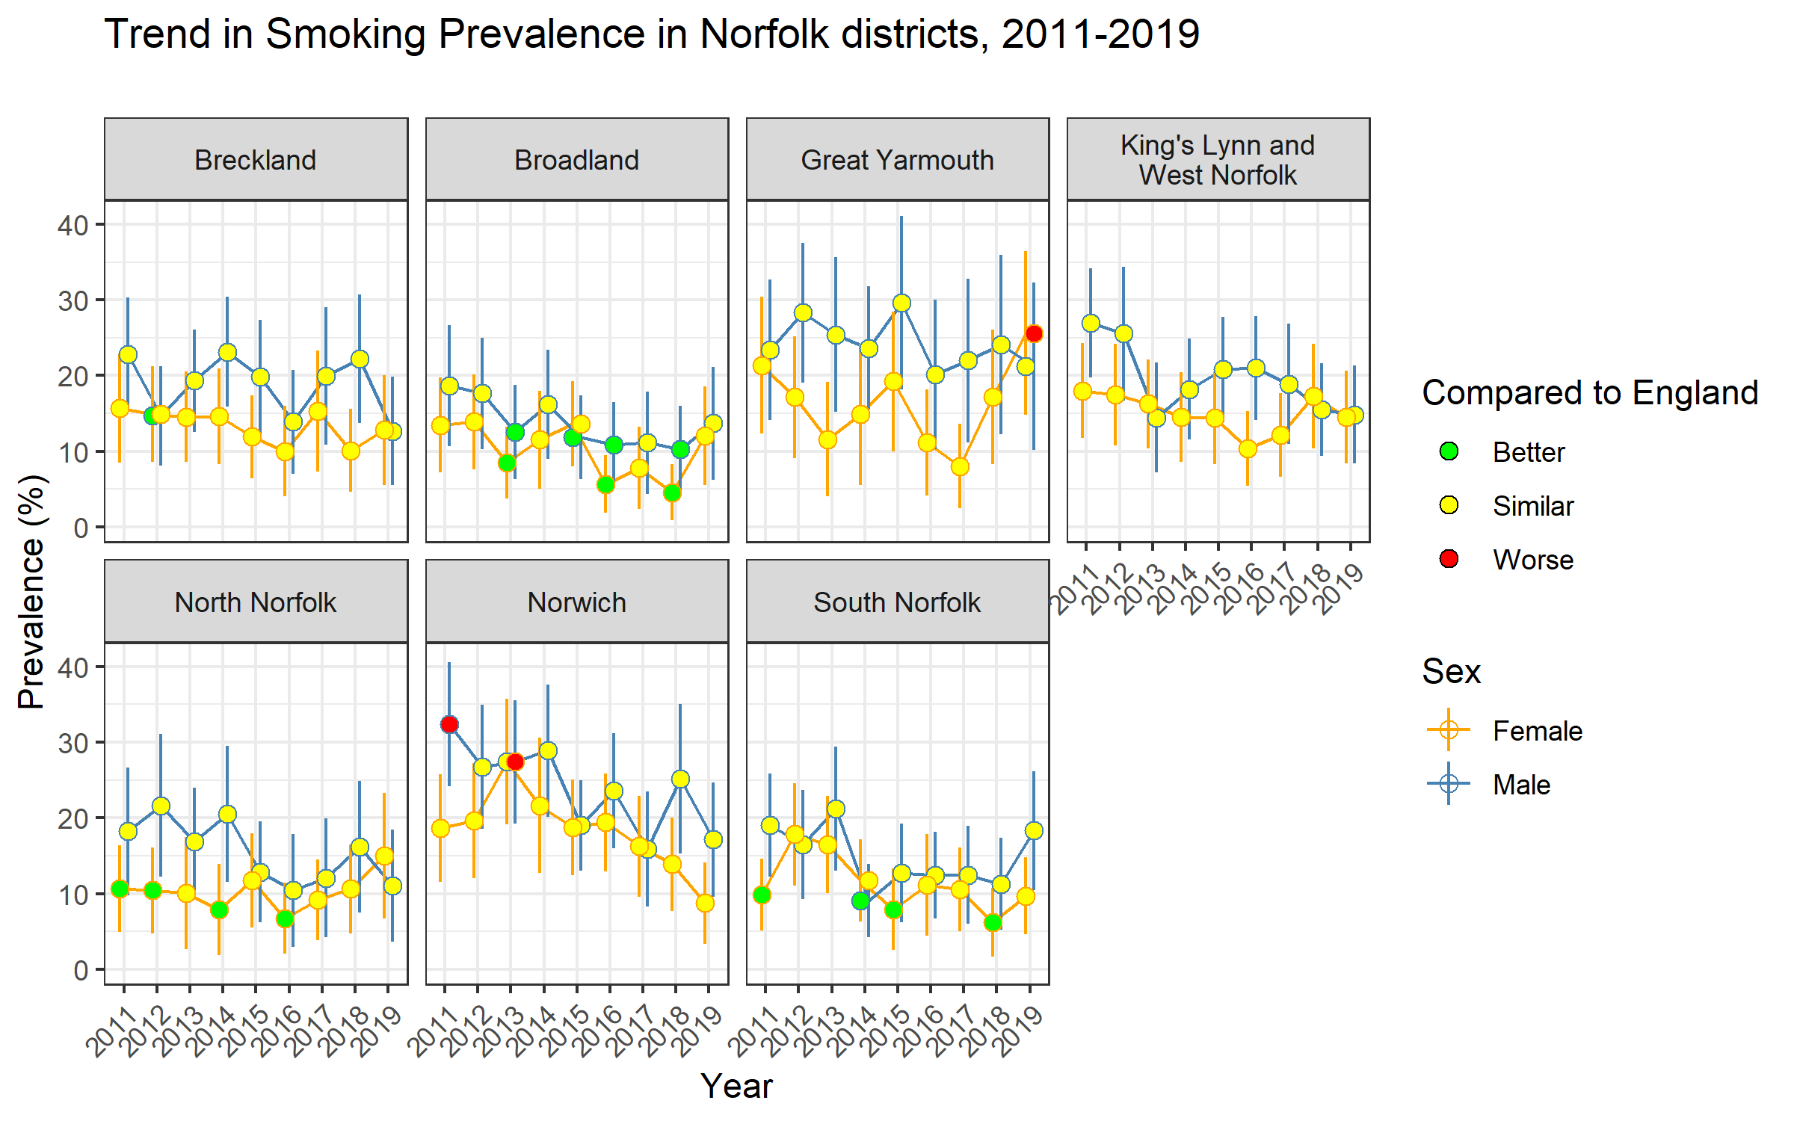
Geographical Inequalities
Prevalence varies across Norfolk with the highest in Great Yarmouth…
…where it has more than doubled between 2017 and 2019 for adult women.

Slide 6
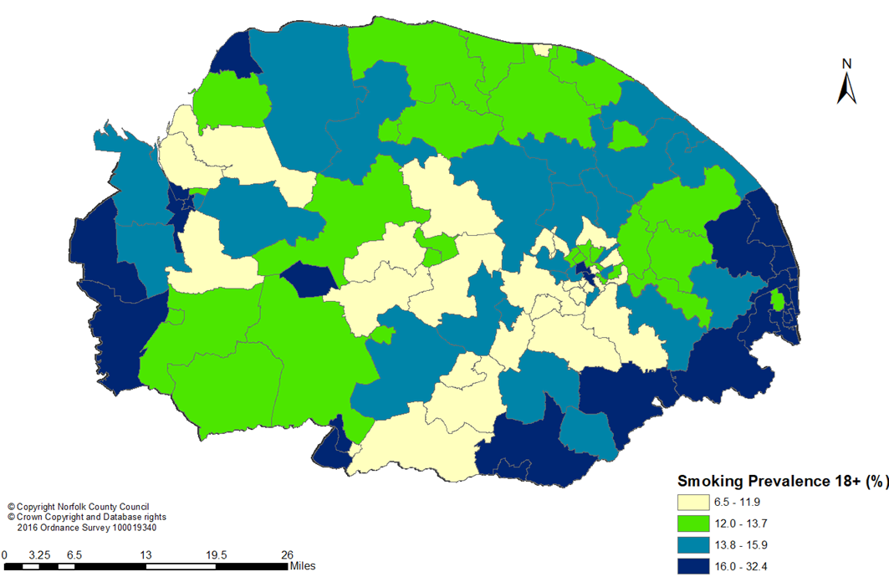
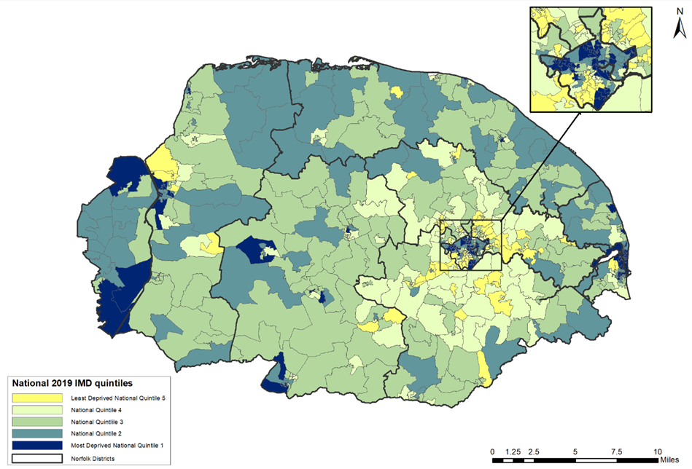
Inequalities
Prevalence aligns closely with deprivation…

Slide 7
Priority Populations

Slide 8
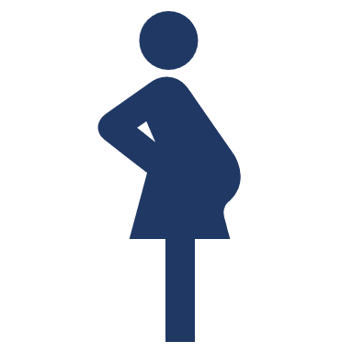
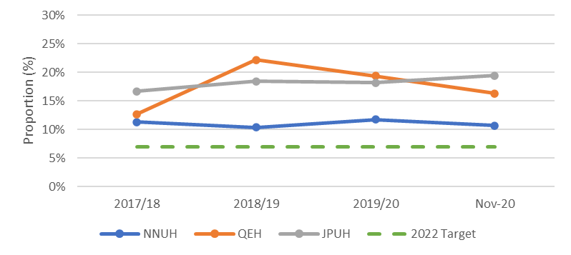
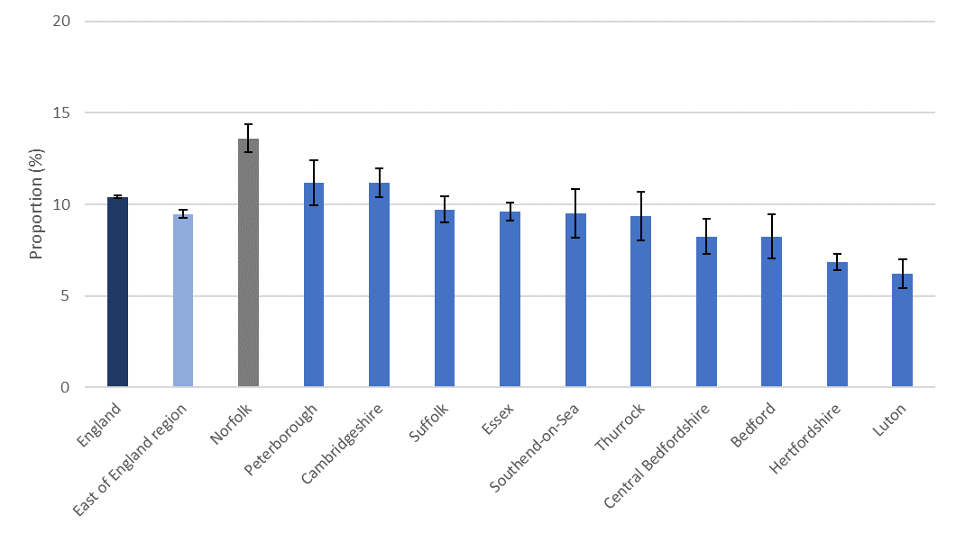
Pregnant Women
Smoking among pregnant women at time of delivery in Norfolk is highest in the East of England region
All three trusts are higher than the local target of 7%, with QEH and JPUH more than double the proportion.

Slide 9
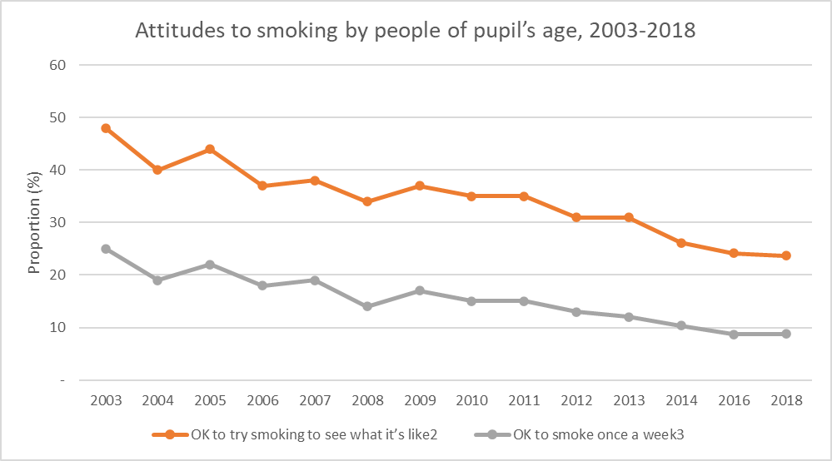
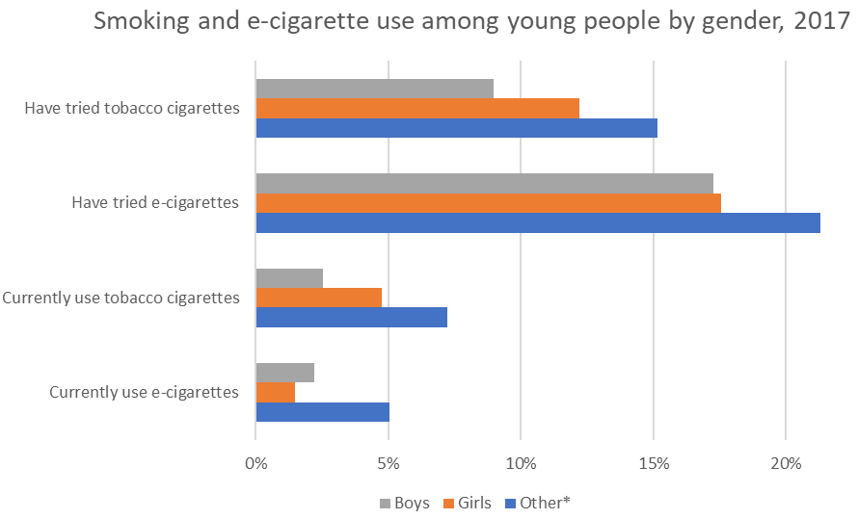
Young People
In Norfolk, a higher proportion of young people have tried e-cigarettes than have smoked traditional tobacco cigarettes, but a higher proportion of young people describe themselves as ‘currently smoking’ as opposed to ‘currently vaping’
Steady decline in young people’s positivity towards smoking.
Young people engaging with the targeted service and quitting is lower than the results achieved in a similar service with adults.

Slide 10
Prisoners
79% of the Norfolk prison population smoke compared to 14.5% of the general Norfolk population
Health Act (2006) that prohibited smoking in nearly all enclosed & public places does not apply to prisons.
Only vaping within cells is permitted within English prisons, shown to significantly reduce the particulate pollution from second-hand smoke.

Slide 11
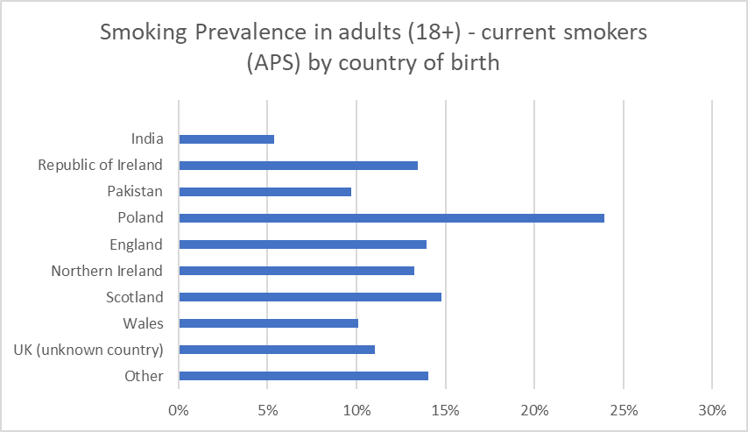
Ethnic Groups
People born in Poland are significantly more likely to smoke tobacco.*
Gypsy Roma and Travellers significantly more likely to be current smokers (57% compared to 21.5% in the comparator group).
Use of smokeless tobacco products is much more prevalent within South Asian communities.
*Data on country of birth and smoking prevalence is only available at a national level for England.

Slide 12
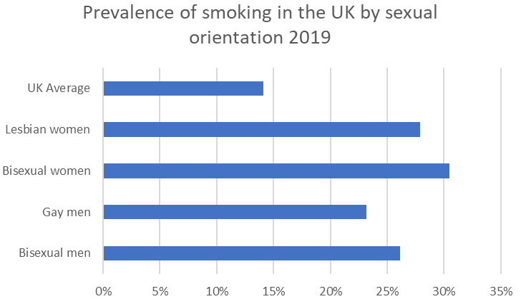
Sexual and Gender Identity
Members of LGBTQ+ communities are significantly more likely to report being an ever smoker, or current smoker compared to their heterosexual or straight peers.*
No current or reliably accurate figure for the prevalence of tobacco among transgender people in the UK is available.
*Data is only available at a UK level.

Slide 13
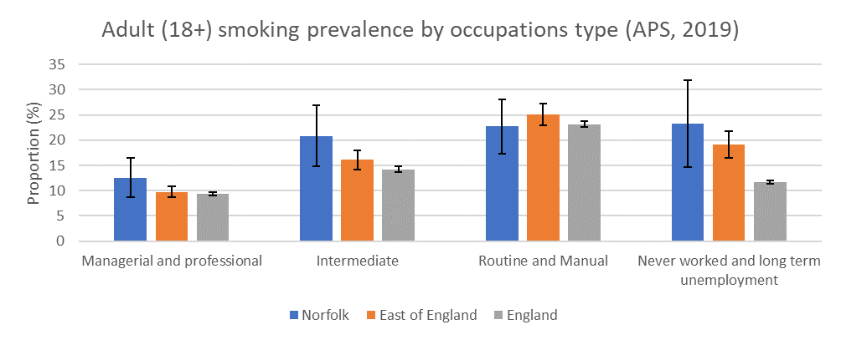
Manual Workers
Routine and manual labour workers are most likely to smoke.
Pronounced in KLWN where it is estimated that routine and manual workers are 3x more likely to smoke than other workers.

Slide 14
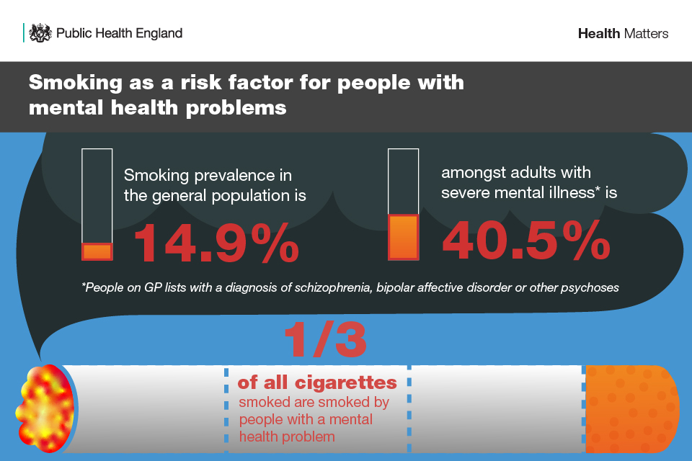
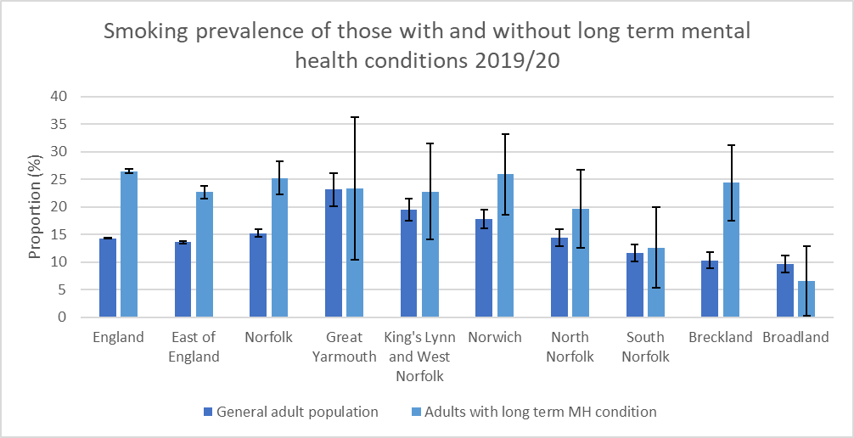
Mental Health
Significant difference in prevalence of tobacco smoking between those with and without a long-term mental health condition in Norfolk.

Slide 15
Impact of COVID-19

Slide 16
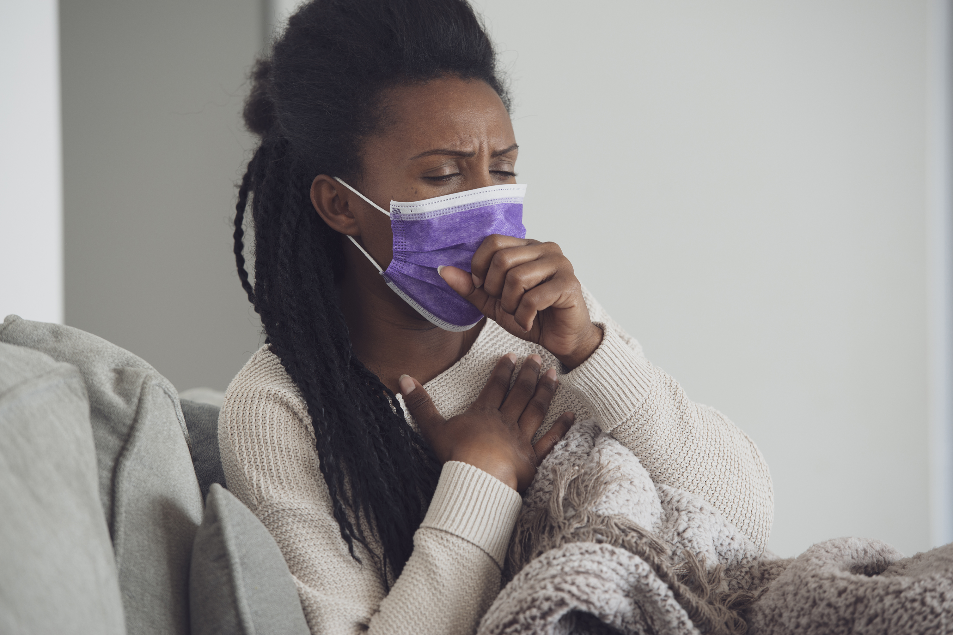
Impact of COVID-19
Direct:
Smoking can play a role in making a person more susceptible to infection, severe illness and hospitalisation from COVID-19 .
Indirect:
Trading standards enforcement efforts on illicit tobacco
Reduced capacity to delivery smoking cessation treatment via GPs and pharmacies
By far the most popular choice of intervention among successful 4-week quitters was one-to-one sessions, since March 2020 all of these sessions have since been offered via telephone or online.

Slide 17
Next Steps
Information in Tobacco Health Needs Assessment is intended to inform the updating of the Tobacco Control Strategy for Norfolk.
The current strategy is now out of date, the update having been delayed by the COVID-19 pandemic.
This report should guide the prioritisation and planning of future work and be used to support the commissioning of future services.

