Slide 1
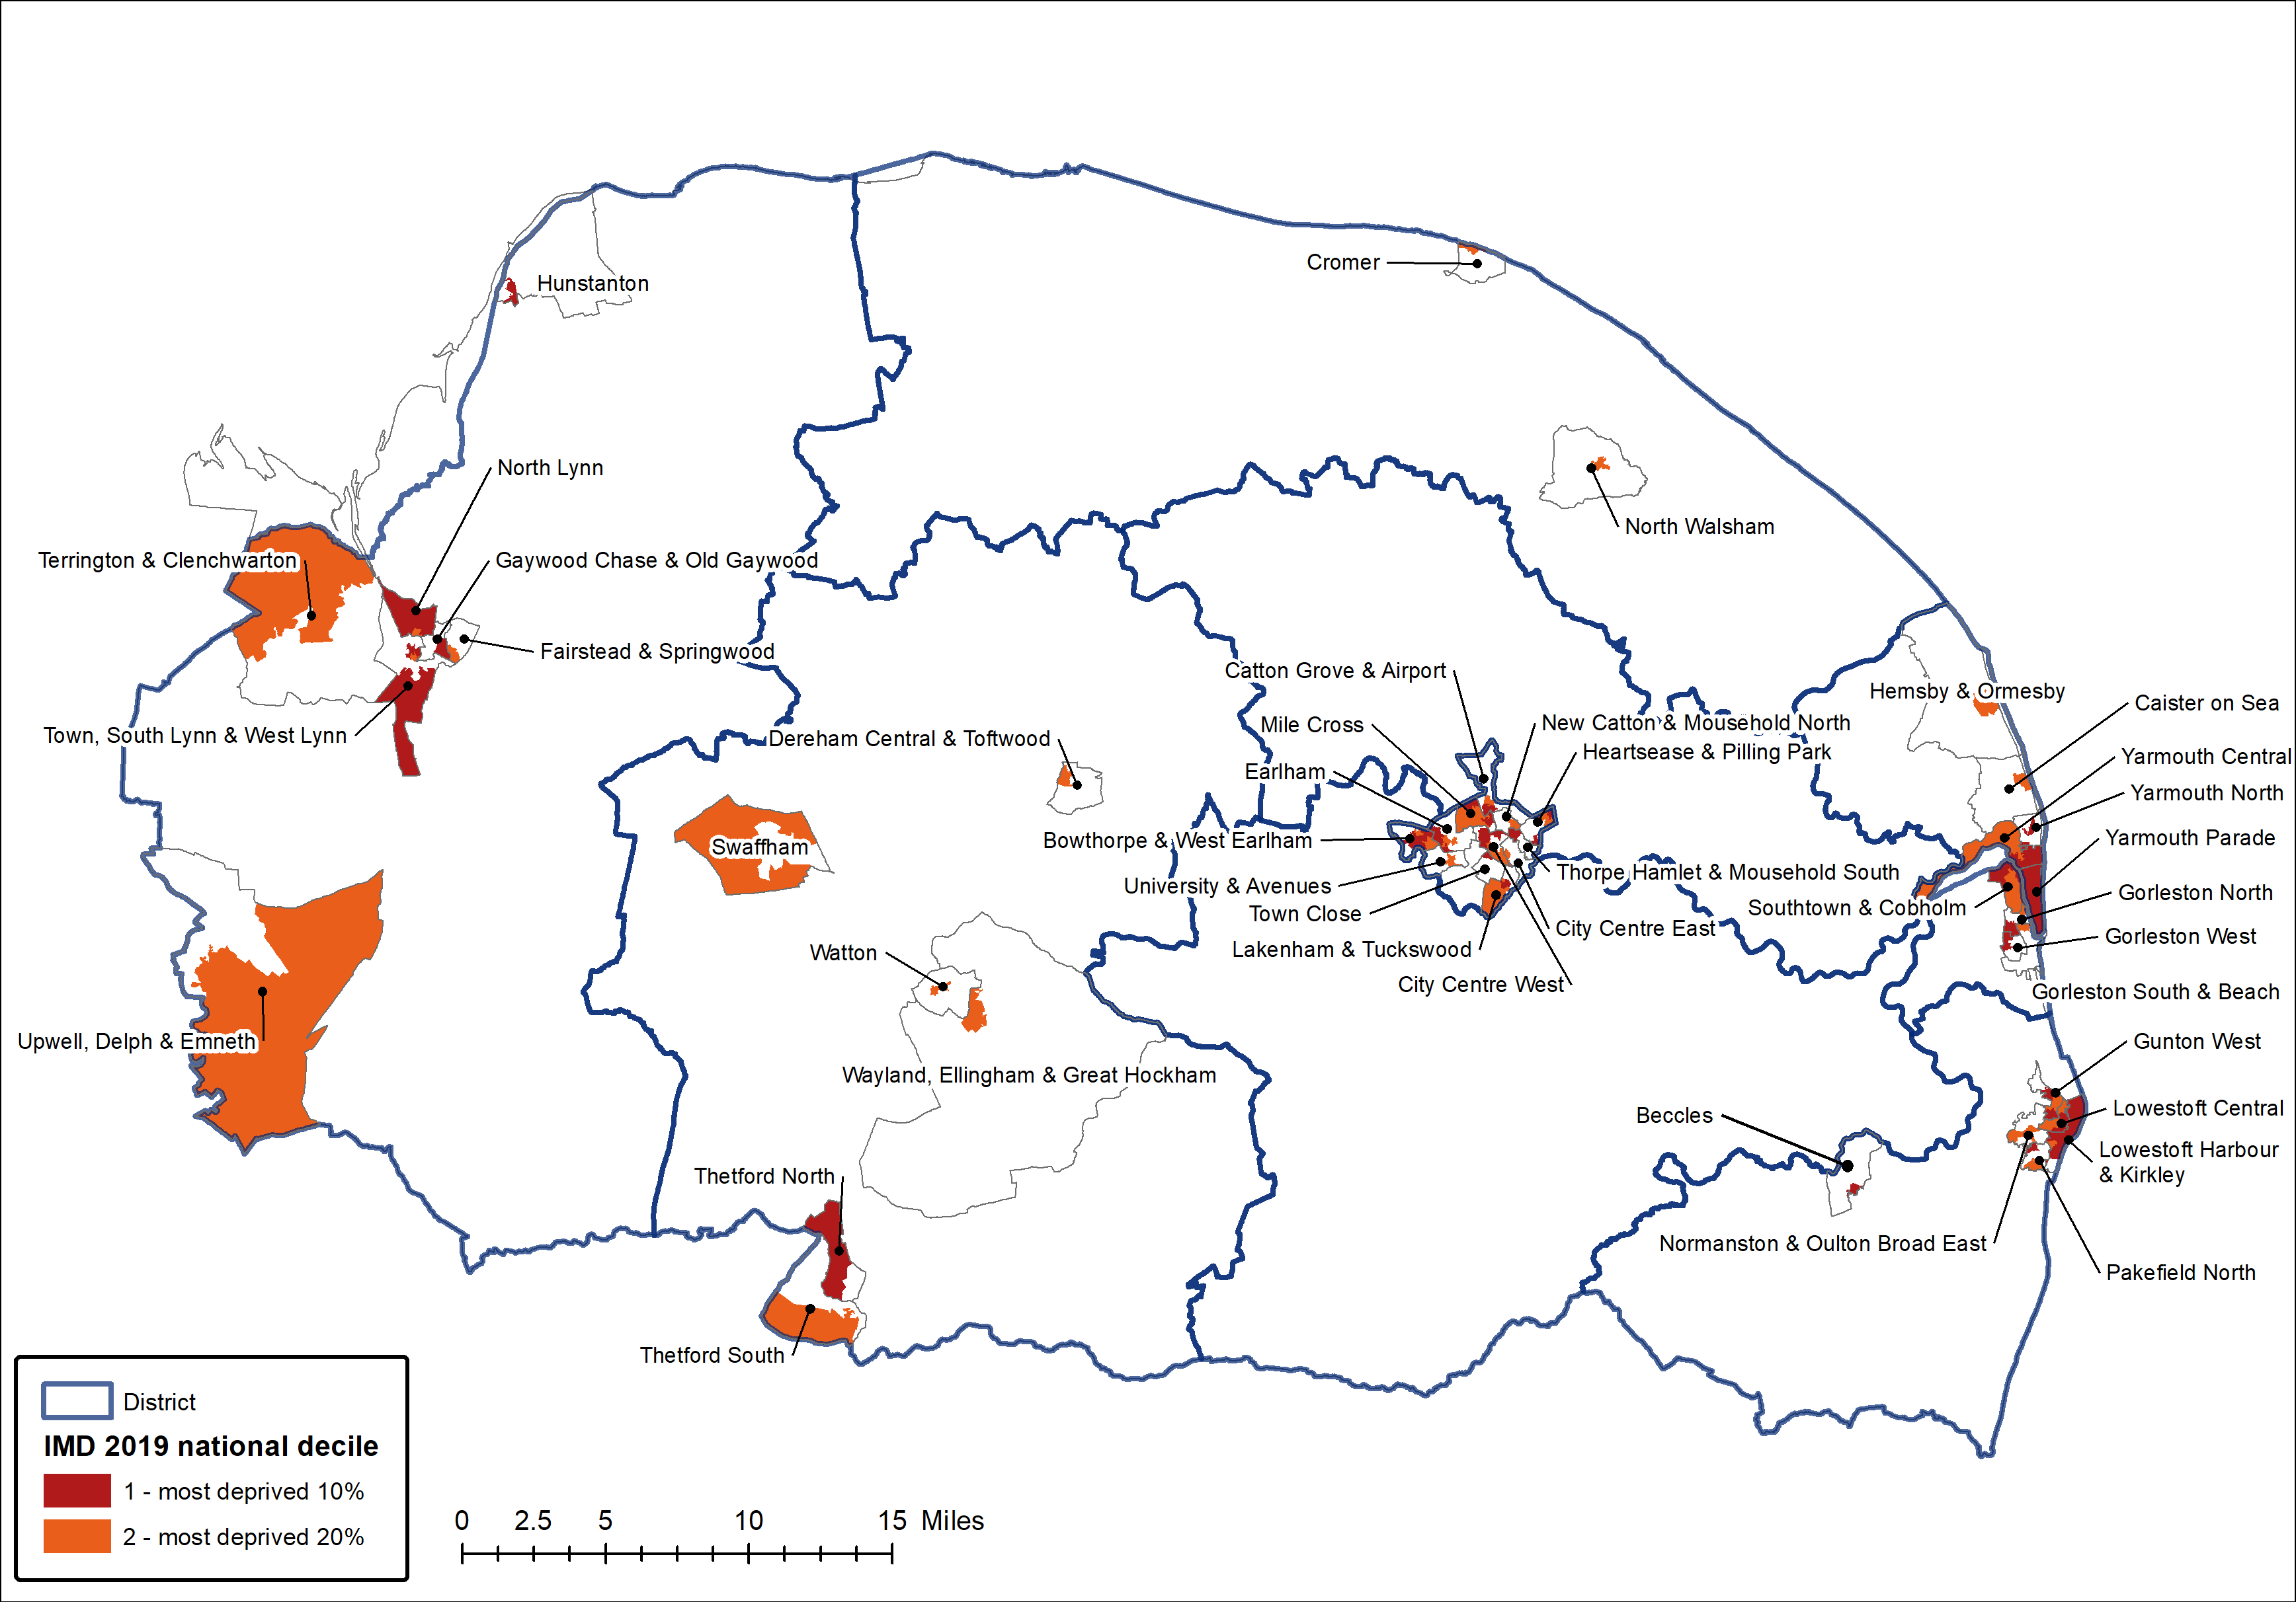
Deprivation & Wider Determinants of Health
District | Most deprived decile 1 Core 20 | Most deprived decile 2 Core 20 | Other deciles | Core 20 Population
Breckland | 2,500 | 12,300 | 126,500 | 14,700
Broadland | 0 | 0 | 131,900 | 0
Great Yarmouth | 26,900 | 12,800 | 59,500 | 39,700
KLWN | 12,100 | 11,200 | 127,900 | 23,300
North Norfolk | 0 | 2,800 | 102,400 | 2,800
Norwich | 27,400 | 28,100 | 86,700 | 55,500
South Norfolk | 0 | 0 | 143,100 | 0
Waveney | 16,000 | 11,800 | 90,700 | 27,900
Norfolk and Waveney | 84,900 | 78,900 | 868,800 | 163,800
England | 5,603,900 | 5,697,200 | 45,249,000 | 11,301,100
District | Most deprived decile 1 Core 20 | Most deprived decile 2 Core 20 | Other deciles | Core 20 Population
Breckland | 1.7% | 8.7% | 89.6% | 10.4%
Broadland | 0.0% | 0.0% | 100.0% | 0.0%
Great Yarmouth | 27.1% | 12.9% | 60.0% | 40.0%
KLWN | 8.0% | 7.4% | 84.6% | 15.4%
North Norfolk | 0.0% | 2.6% | 97.4% | 2.6%
Norwich | 19.3% | 19.7% | 61.0% | 39.0%
South Norfolk | 0.0% | 0.0% | 100.0% | 0.0%
Waveney | 13.5% | 10.0% | 76.5% | 23.5%
Norfolk and Waveney | 8.2% | 7.6% | 84.1% | 15.9%
England | 9.9% | 10.1% | 80.0% | 20.0%
There are 42 communities across Norfolk and Waveney where some or all the population live in the 20% most deprived areas in England. However, none of these communities are in Broadland or South Norfolk.
Approximately 40% of the populations of Great Yarmouth and Norwich live in the most deprived 20% of areas in England compared to 16% for Norfolk and Waveney as a whole.

