Slide 1
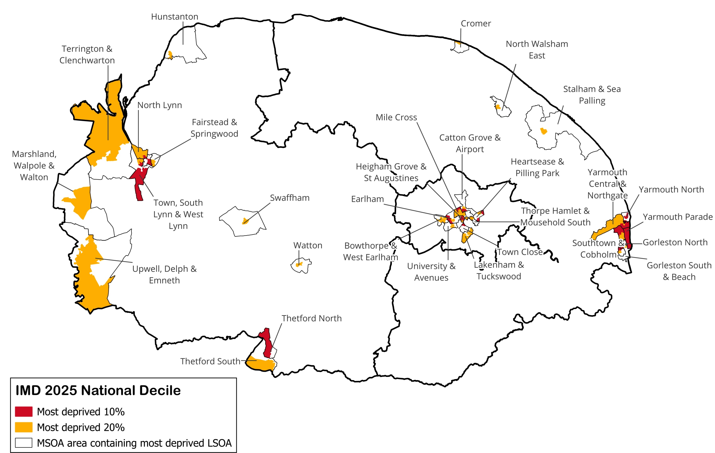
Index of Multiple Deprivation 2025
All age population (2024)
District | Most deprived decile 1 Core 20 | Most deprived decile 2 Core 20 | Core 20 Population | Other deciles
East Norfolk | 26,754 | 11,672 | 38,426 | 302,905
West Norfolk | 11,259 | 28,060 | 39,319 | 270,418
Greater Norwich | 16,059 | 30,436 | 46,495 | 242,796
Norfolk | 54,072 | 70,168 | 124,240 | 816,119
England | 5,948,978 | 5,940,147 | 11,889,125 | 46,730,976
District | Most deprived decile 1 Core 20 | Most deprived decile 2 Core 20 | Core 20 Population | Other deciles
East Norfolk | 7.8% | 3.4% | 11.3% | 88.7%
West Norfolk | 3.6% | 9.1% | 12.7% | 87.3%
Greater Norwich | 5.6% | 10.5% | 16.1% | 83.9%
Norfolk | 5.8% | 7.5% | 13.2% | 86.8%
England | 10.1% | 10.1% | 20.3% | 79.7%
There are 32 communities (73 LSOAs) across Norfolk where some or all the population live in the 20% most deprived areas in England.

Slide 2
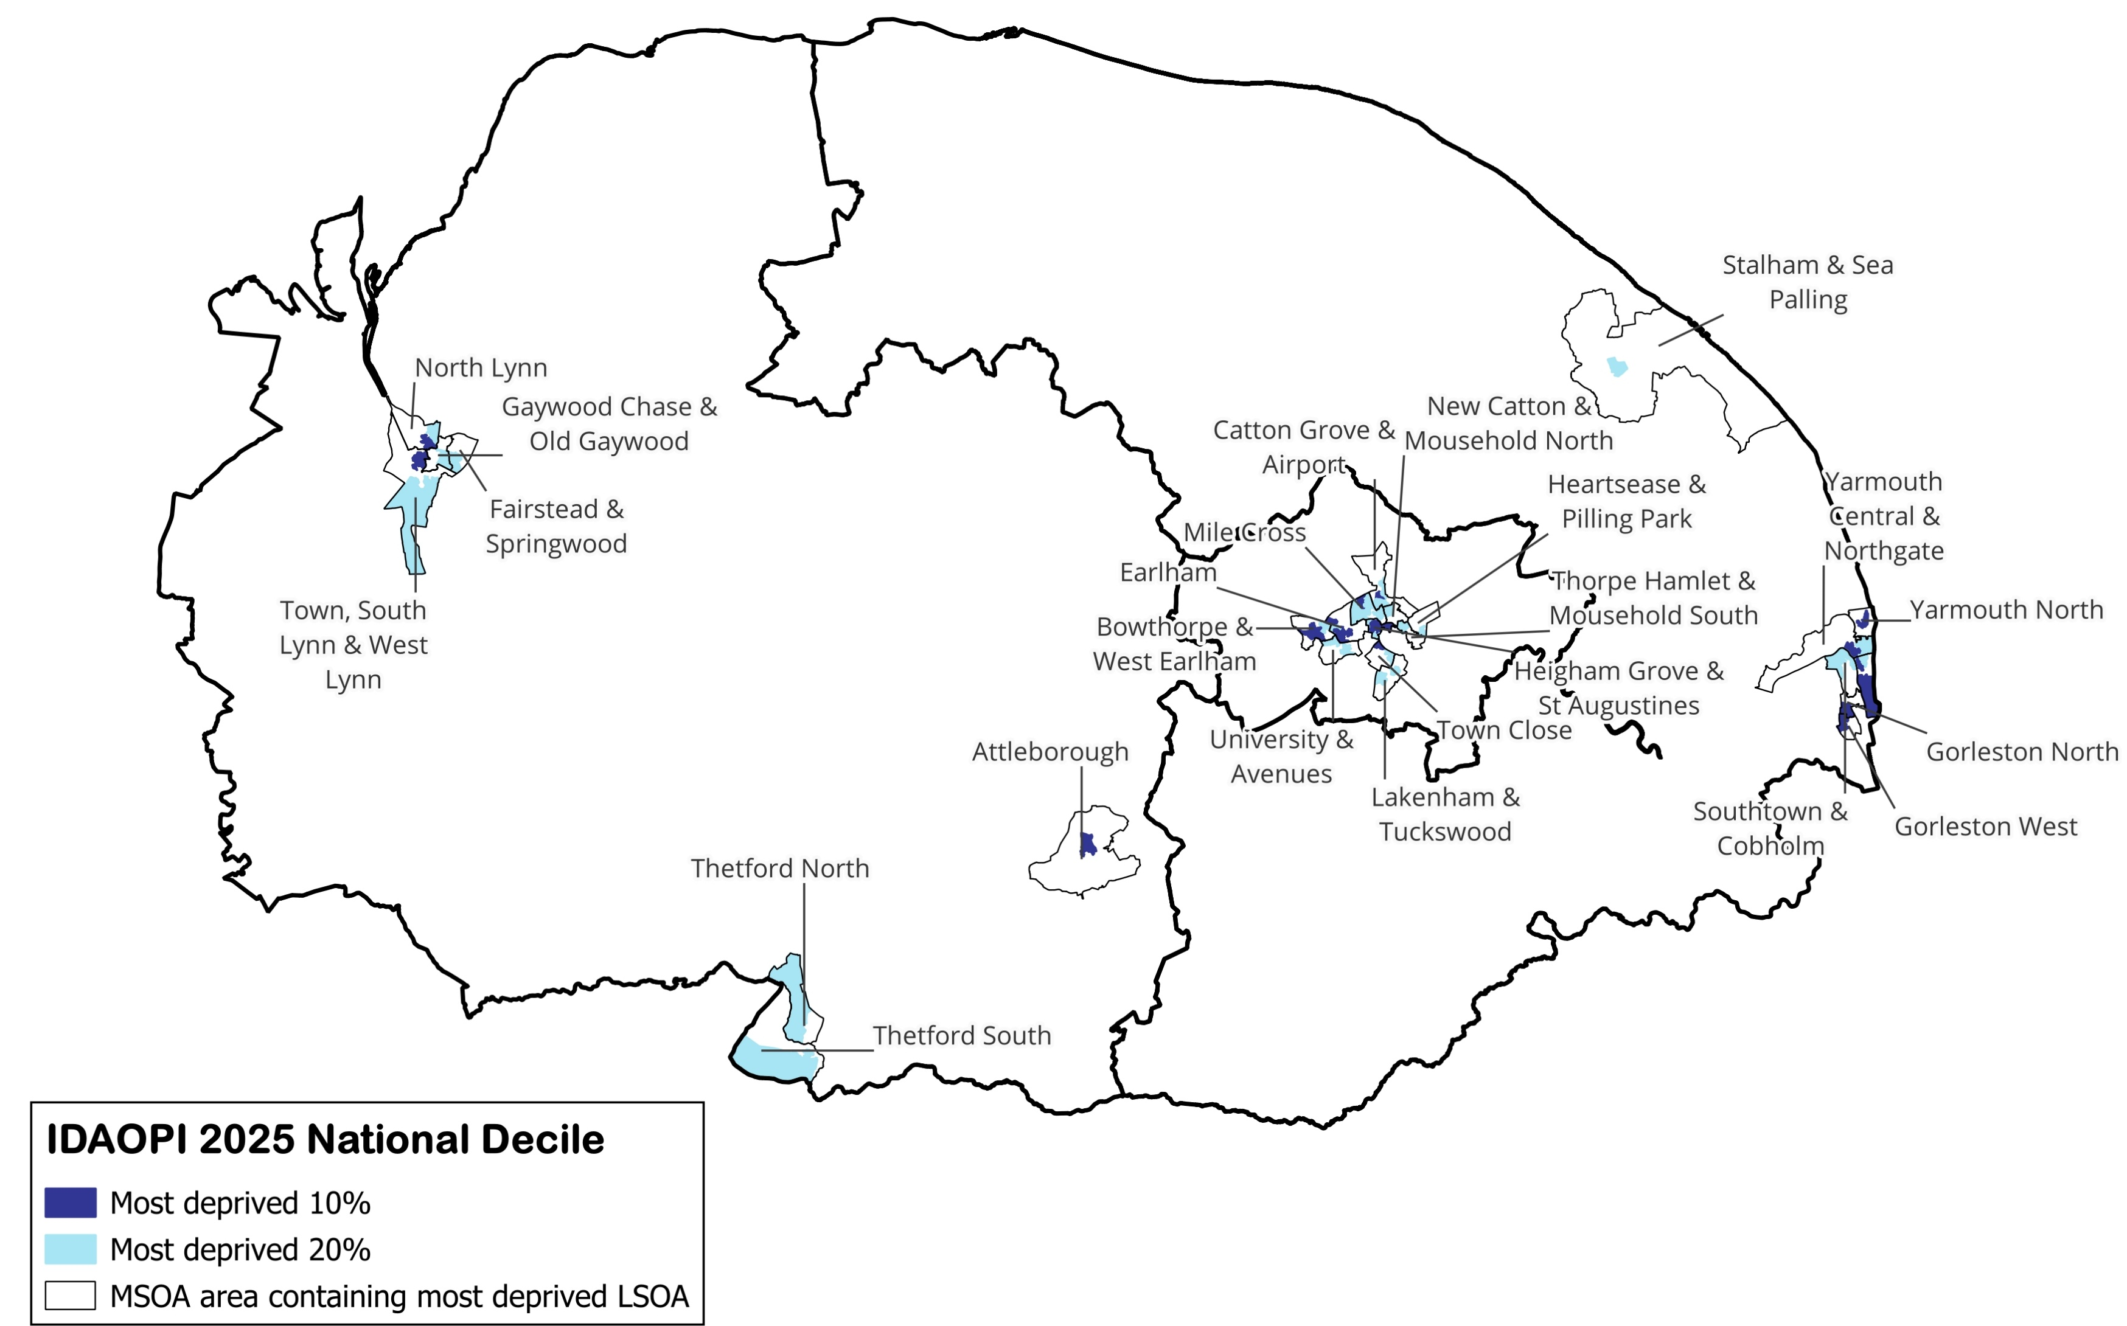
Income Deprivation Affecting Older People Index 2025
Age 60+ population (2024)
District | Most deprived decile 1 | Most deprived decile 2 | Core 20 Population | Other deciles
East Norfolk | 2,619 | 2,304 | 4,923 | 120,678
West Norfolk | 1,446 | 2,550 | 3,996 | 99,893
Greater Norwich | 2,762 | 5,666 | 8,428 | 62,628
Norfolk | 6,827 | 10,520 | 17,347 | 283,199
England | 861,858 | 1,054,332 | 1,916,190 | 12,627,681
District | Most deprived decile 1 Core 20 | Most deprived decile 2 Core 20 | Core 20 Population | Other deciles
East Norfolk | 2.1% | 1.8% | 3.9% | 96.1%
West Norfolk | 1.4% | 2.5% | 3.8% | 96.2%
Greater Norwich | 3.9% | 8.0% | 11.9% | 88.1%
Norfolk | 2.3% | 3.5% | 5.8% | 94.2%
England | 5.9% | 7.2% | 13.2% | 86.8%
There are 25 communities (53 LSOAs) across Norfolk where some or all the population live in the worst 20% for deprivation affecting older people in England.

Slide 3
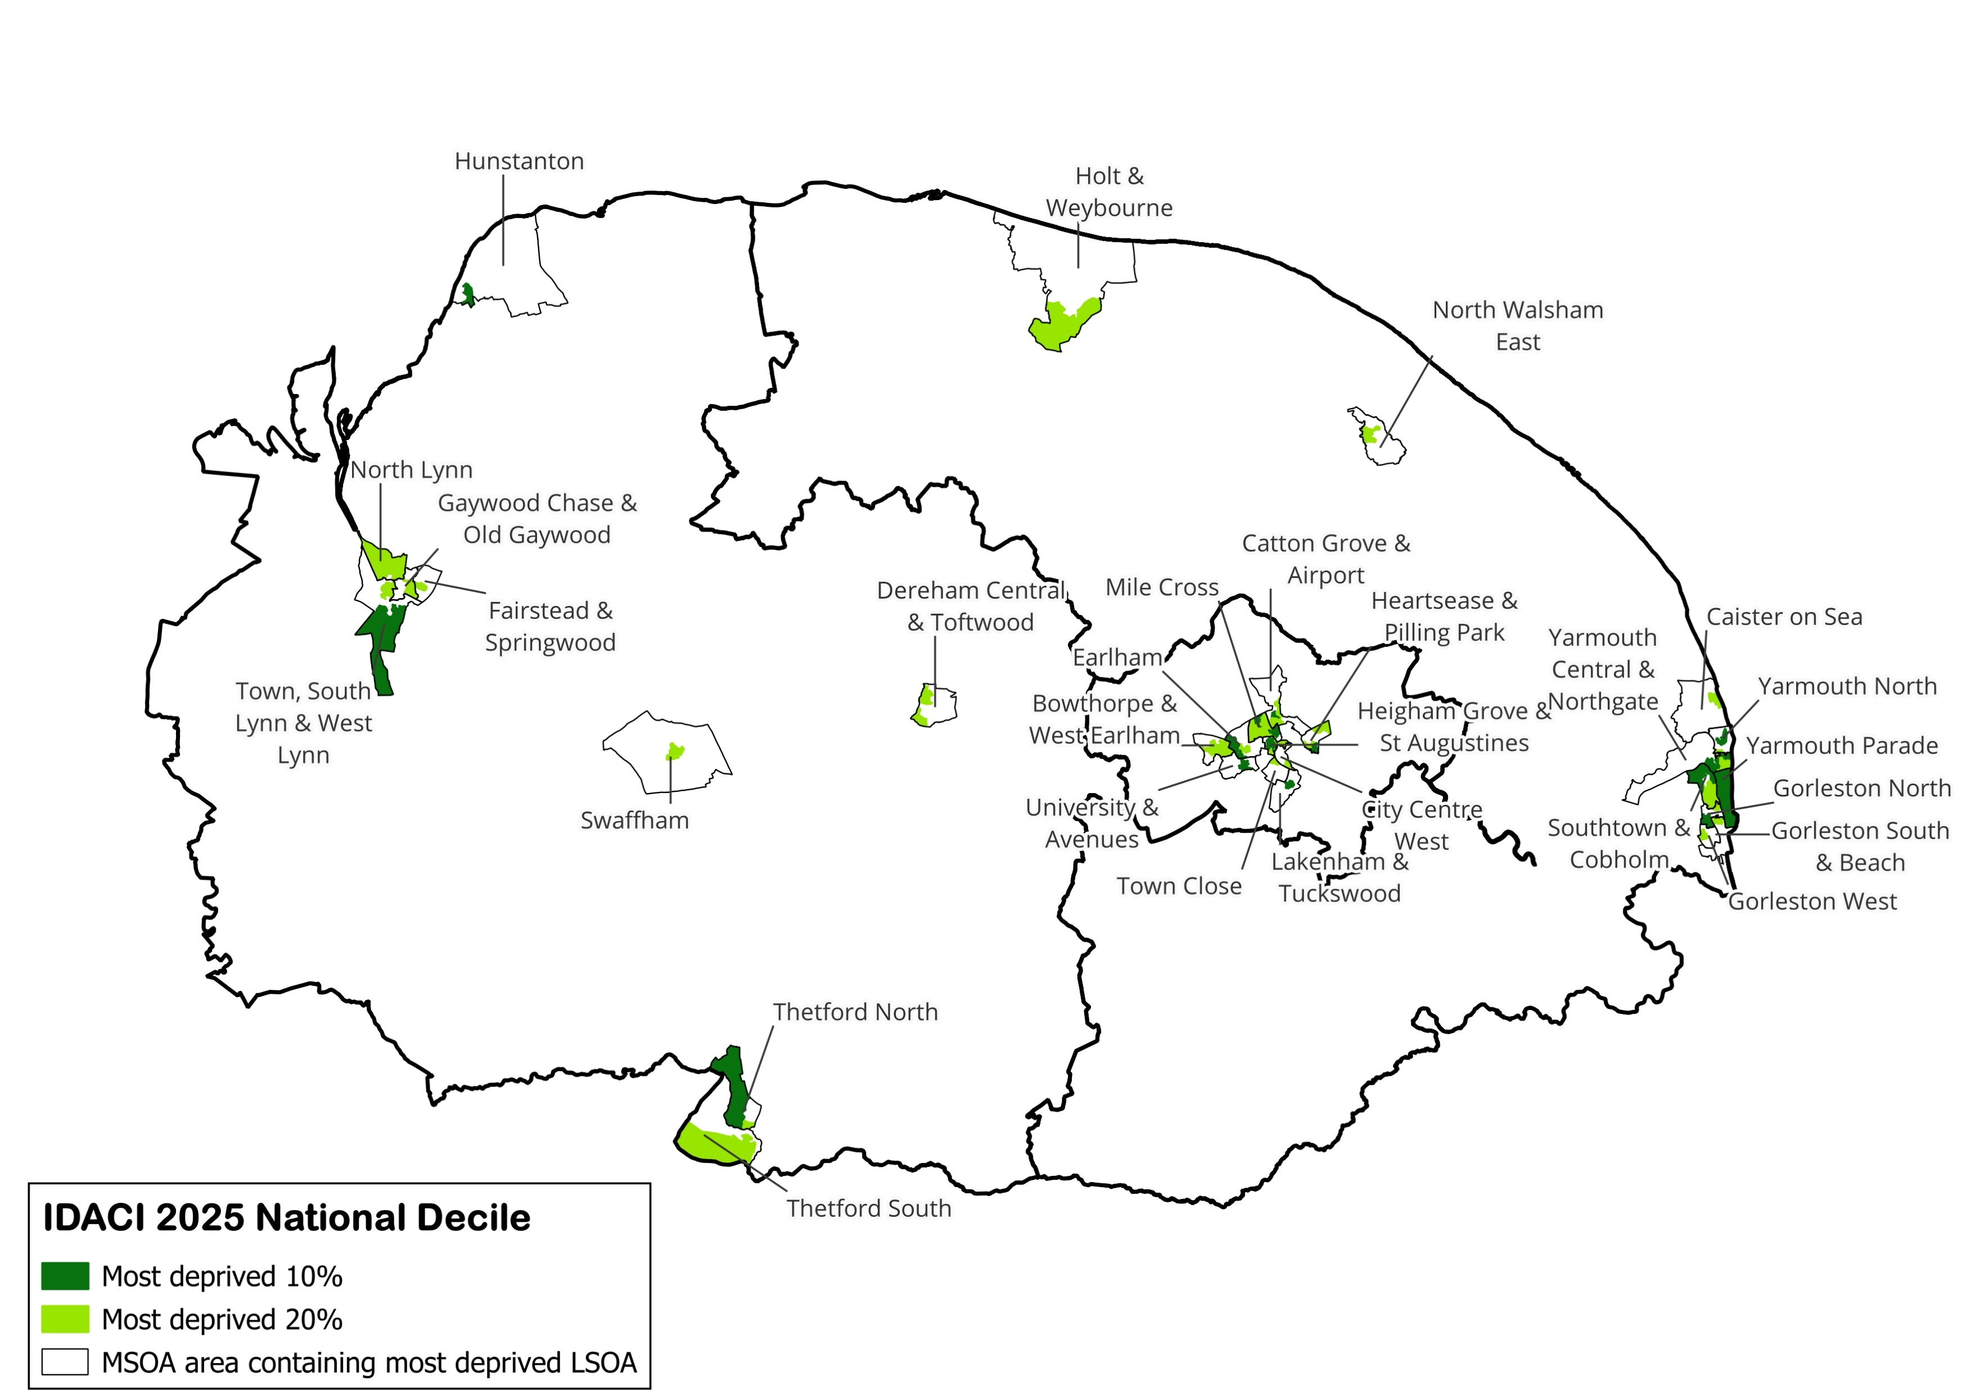
Income Deprivation Affecting Children Index 2025
Age 0-15 population (2024)
District | Most deprived decile 1 | Most deprived decile 2 | Core 20 Population | Other deciles
East Norfolk | 4,582 | 3,090 | 7,672 | 44,718
West Norfolk | 1,269 | 4,747 | 6,016 | 44,784
Greater Norwich | 3,253 | 5,609 | 8,862 | 39,494
Norfolk | 9,104 | 13,446 | 22,550 | 128,996
England | 1,366,756 | 1,264,595 | 2,631,351 | 8,136,897
District | Most deprived decile 1 Core 20 | Most deprived decile 2 Core 20 | Core 20 Population | Other deciles
East Norfolk | 8.7% | 5.9% | 14.6% | 85.4%
West Norfolk | 2.5% | 9.3% | 11.8% | 88.2%
Greater Norwich | 6.7% | 11.6% | 18.3% | 81.7%
Norfolk | 6.0% | 8.9% | 14.9% | 85.1%
England | 12.7% | 11.7% | 24.4% | 75.6%
There are 29 communities (65 LSOAs) across Norfolk where some or all the population live in the worst 20% for deprivation affecting children in England.

